Slide 1

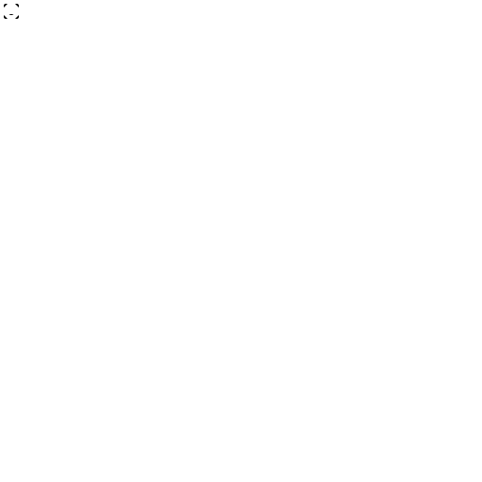


Cloud Attendance System
with Face Recognition
AI-Powered Smart Attendance Management
Real-time face verification
Secure cloud-synced attendance records
Zero-proxy, AI-driven accuracy
B RUTHESH (192521465)
MONISH KUMAR (192521214)
DILLI BABU (192521491)
JOTHI KRISHNAN (192524163)
PROJECT PRESENTATION
CLOUD ATTENDANCE • AI
1 / 10
Notes:
Welcome the panel. Introduce the project title, your branch, and give a one-line hook about solving proxy attendance and manual errors with AI + cloud.

Slide 2





THE CHALLENGE
Why Traditional Attendance Fails
Time Consuming
Manual roll-call eats 10–15 minutes of every class.
Proxy Attendance
Students mark attendance for absent friends.
Manual Errors
Human mistakes in counting & recording entries.
No Real-Time View
Faculty can't monitor attendance as it happens.
Poor Record Keeping
Registers get lost, damaged, or hard to audit.
PROBLEM STATEMENT
CLOUD ATTENDANCE • AI
2 / 10
Notes:
Explain each pain point briefly: time loss, proxy attendance, human error, lack of real-time visibility, fragile physical records.

Slide 3



OUR APPROACH
The Proposed Solution
AI Face Recognition
Deep-learning models identify each student instantly and accurately.
Cloud Storage Integration
Attendance & student data synced securely to the cloud.
Automated Attendance Marking
No manual entry — attendance logs itself once a face is verified.
Real-Time Monitoring
Faculty see attendance update live, class by class.
Smart Analytics Dashboard
Auto-generated insights, trends and exportable reports.
PROPOSED SOLUTION
CLOUD ATTENDANCE • AI
3 / 10
Notes:
Walk through the five pillars: AI recognition, cloud integration, automation, real-time monitoring, and analytics.

Slide 4







ARCHITECTURE
System Architecture
1. Student Face
5. Cloud Database
presents face to the camera on entry
verified record stored & synced
2. Camera Detection
6. Attendance Processing
edge camera captures live video frame
timestamp, subject & status logged
3. Face Recognition
7. Faculty Dashboard
CNN model extracts facial embeddings
live status visible to faculty
4. AI Verification
8. Reports Generation
match confidence checked vs. database
auto analytics & exportable reports
SYSTEM ARCHITECTURE
CLOUD ATTENDANCE • AI
4 / 10
Notes:
Trace the pipeline: face capture, recognition, verification, cloud storage, processing, dashboard, and reports.

Slide 5






TECH STACK
Technologies Powering the System
Face Recognition
Python
Firebase / AWS
identity matching engine
primary programming language
cloud hosting & storage
Artificial Intelligence
OpenCV
SQL Database
core intelligence layer
computer vision processing
structured attendance records
Cloud Computing
Deep Learning
Web Dashboard
scalable infrastructure
CNN-based model training
faculty-facing interface
TECHNOLOGIES USED
CLOUD ATTENDANCE • AI
5 / 10
Notes:
Group the stack into AI/vision, infrastructure, and application layers while presenting.

Slide 6




HOW IT WORKS
The Working Process
1. Student enters the classroom
2. Camera captures the face
3. Face gets verified
4. Cloud processes the information
5. Attendance gets updated automatically
6. Faculty receives live updates
WORKING PROCESS
CLOUD ATTENDANCE • AI
6 / 10
Notes:
Narrate the six-step journey from entry to live faculty update — the whole loop completes in seconds.

Slide 7




TRUST & SAFETY
Security Features
Encrypted Cloud Storage
Secure Login Authentication
All records encrypted at rest and in transit.
Role-based access for faculty & admins.
Face Verification
Real-Time Monitoring
Only registered, matched faces are accepted.
Suspicious activity flagged instantly.
Anti-Spoof Detection
Backup Systems
Blocks photos, videos & mask-based spoofing.
Automated redundant backups prevent data loss.
SECURITY FEATURES
CLOUD ATTENDANCE • AI
7 / 10
Notes:
Present the six protections: encryption, face verification, anti-spoofing, secure login, live monitoring, and backups.

Slide 8




IMPACT
Key Advantages
99% Recognition Accuracy
Saves Time
Cloud Backup
cuts attendance to seconds
records never lost
Paperless System
Easy Management
no manual paperwork
simple dashboard
Secure Attendance
Scalable Architecture
spoof-resistant marking
one room to full campus
Real-Time Reports
instant analytics
ADVANTAGES
CLOUD ATTENDANCE • AI
8 / 10
Notes:
Lead with the 99% accuracy stat, then the seven advantages: time saved, paperless, secure, live reports, cloud backup, easy management, scalable.

Slide 9





ROADMAP
Future Enhancements
AI Emotion Detection
Smart Notifications
gauge classroom engagement
instant absentee alerts
Multi-Face Recognition
GPS-Based Verification
verify a group in one frame
location-aware attendance
Mobile App Integration
Blockchain Security
attendance & alerts on the go
tamper-proof attendance ledger
Voice Authentication
extra verification layer
FUTURE ENHANCEMENTS
CLOUD ATTENDANCE • AI
9 / 10
Notes:
Present as a roadmap: emotion detection, multi-face recognition, mobile app, voice auth, smart notifications, GPS verification, blockchain.

Slide 10
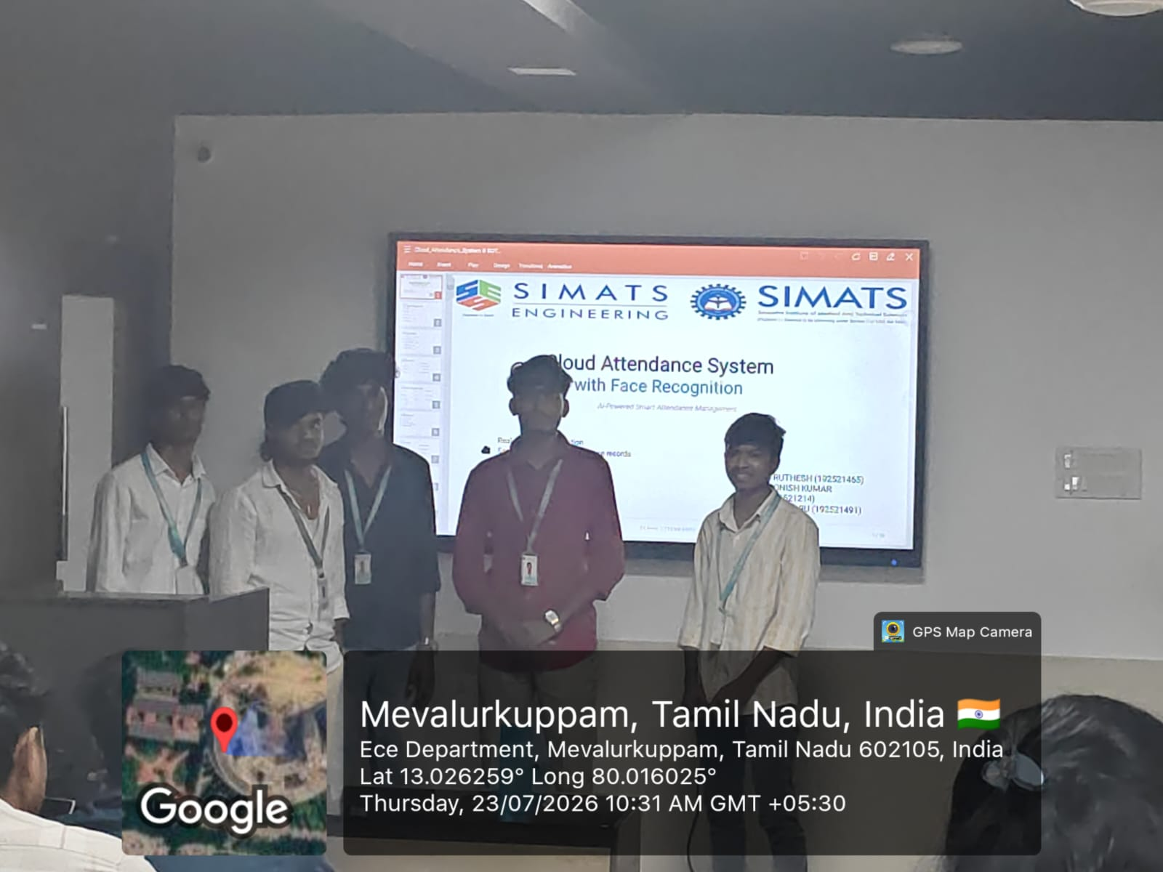

Slide 11


THANK YOU
"Transforming Traditional Attendance into Intelligent Automation"
Smart attendance improves efficiency
Cloud computing provides scalability
Face recognition ensures accuracy
Secure automation reduces human effort
Questions & Discussion Welcome
CONCLUSION
CLOUD ATTENDANCE • AI
10 / 10
Notes:
Summarize the four closing points, restate the tagline, thank the panel, invite questions.

